Slide 1
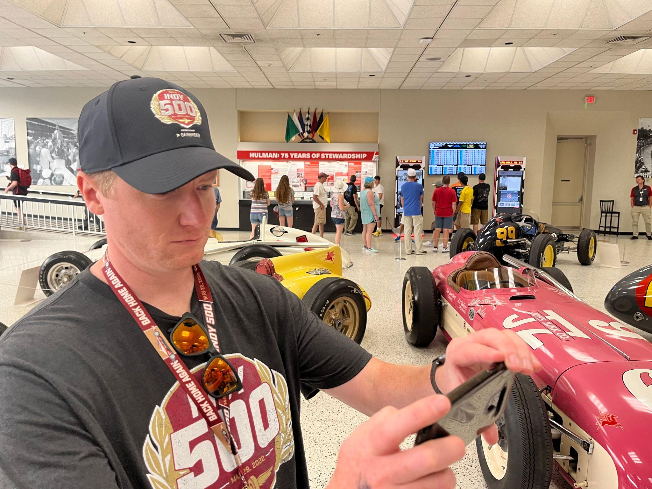
Hello!
Sean Sanders
I am here because I love to give technology presentations.

Slide 2
System Administration 1

Slide 3
Objectives/Learning Outcomes

Slide 4
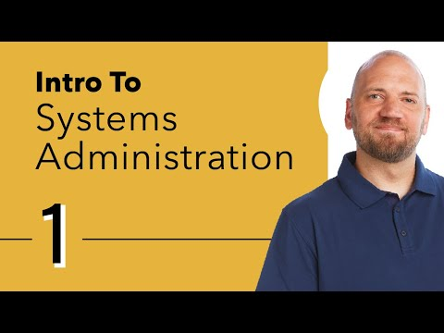

Slide 5
What did you learn/take away from the video?

Slide 6
Linux File System

Slide 7
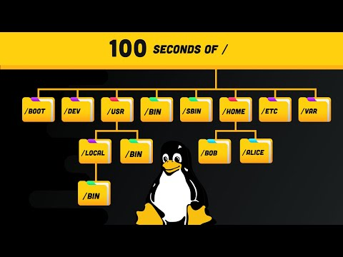

Slide 8
What did you learn/take away from the video?

Slide 9
What to focus on?
Var
Variable files
Root
Located in home directory

Slide 10
Terminal

Slide 11
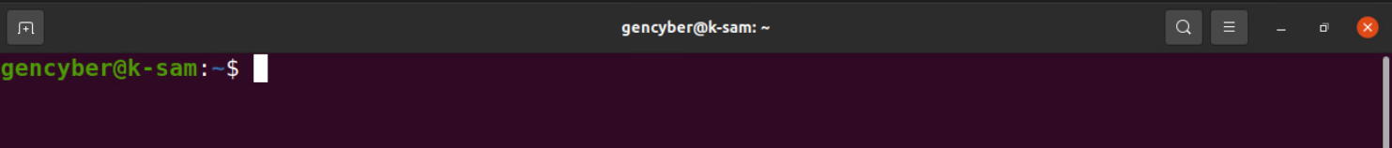
Dollar sign ( $ ) means you are a normal user
~ sign indicates you are at the root folder

Slide 12
Commands we will discuss
Listing contents of a directory
File system Navigation
Adding/Removing users
Adding/Removing groups

Slide 13
What directory am I currently in?

Slide 14
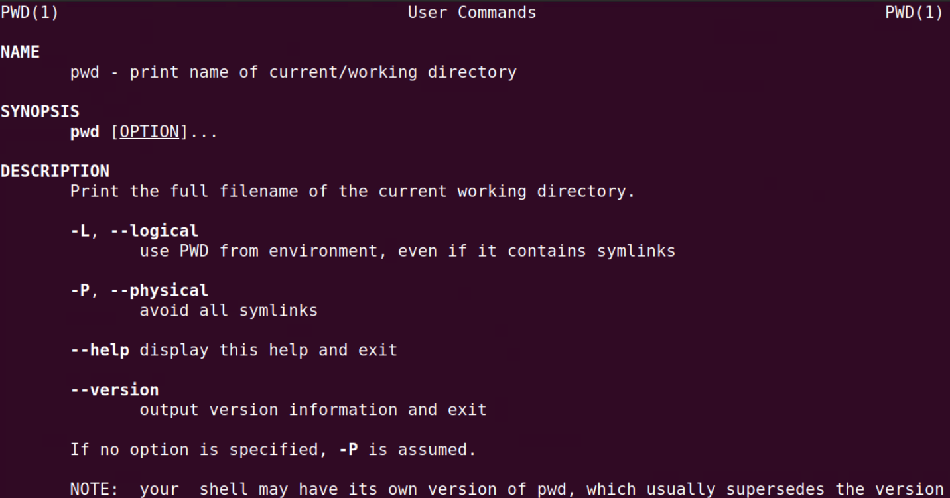

Slide 15
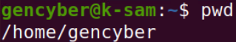
Print name of current working directory
pwd

Slide 16
Searching for help
man [option] [section number] [command name]
option – the search result output
section number – the section in which to look for the man page.
command name – the name of the command which man page you want to see.

Slide 17
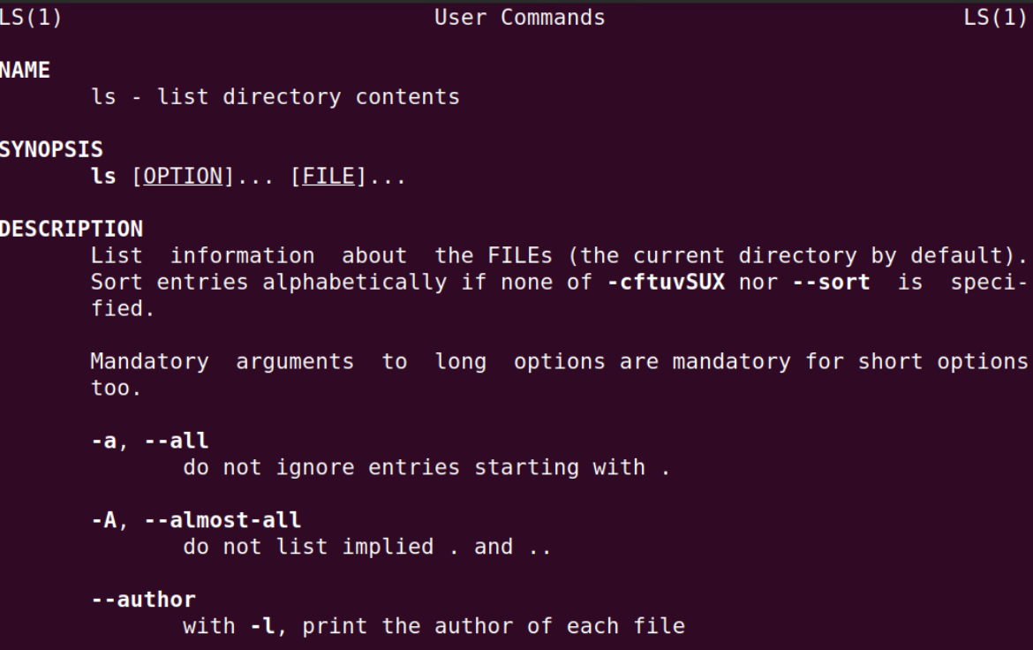
man ls

Slide 18
List Directory Contents

Slide 19
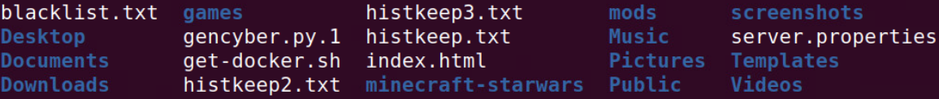
List content
ls

Slide 20
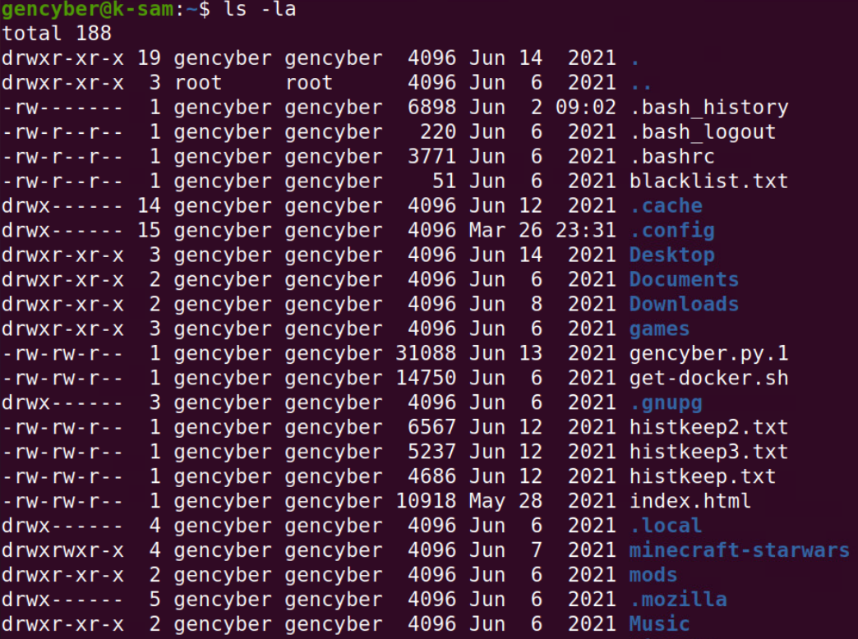
List content contd.
ls -la

Slide 21
Login to your device
Steps:
Login to: https://cdr-vcenter.cse.buffalo.edu/
Use the credentials in the back of your name tags to login.

Slide 22
Exercise (Follow Along)
pwd
ls
ls -la

Slide 23
Change Directory

Slide 24
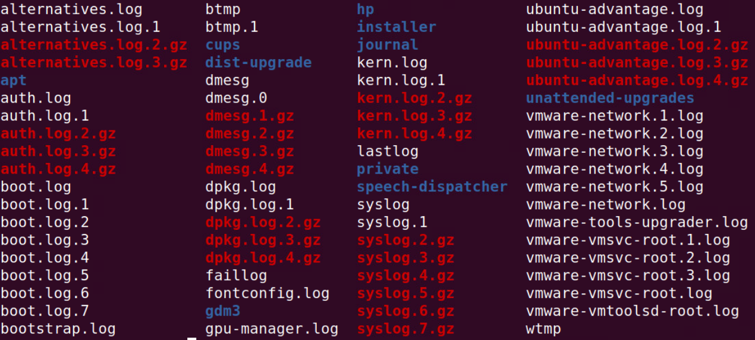
Change directory
cd /var
ls /log

Slide 25
Reading Files

Slide 26
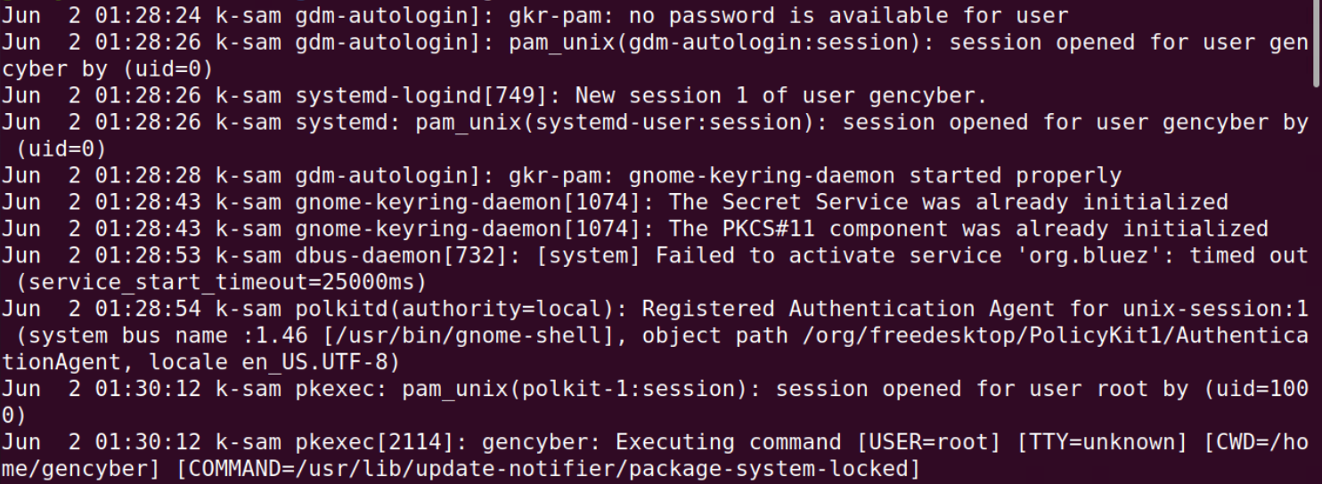
Reading Files
cat /log/auth.log

Slide 27
Exercise (Follow Along)
cd /var
ls /log
cat /log/auth.log

Slide 28
Activity

Slide 29
Easter Egg Hunt (10-15 minutes)
Try to find the following files in various folders located on your file system.
The file names to look for are:
Ant-Man Aquaman Asterix The Atom The Avengers Batgirl Batman Batwoman Black Canary Black Panther
More advanced users: Try to find out file locations without using the change directory and ls commands.

Slide 30
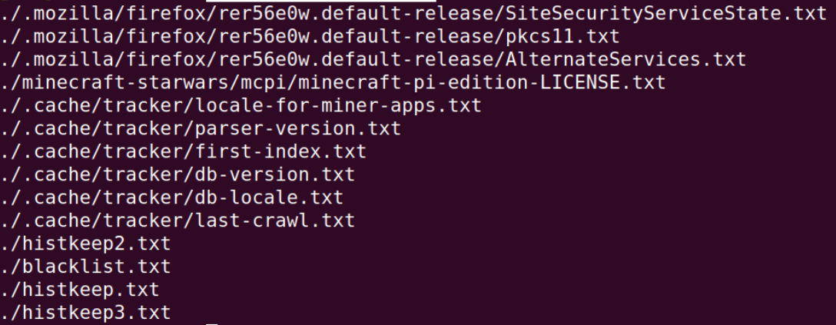
Try to find out file locations without using the change directory and ls commands
find . -name '*.txt'

Slide 31
Create a User

Slide 32
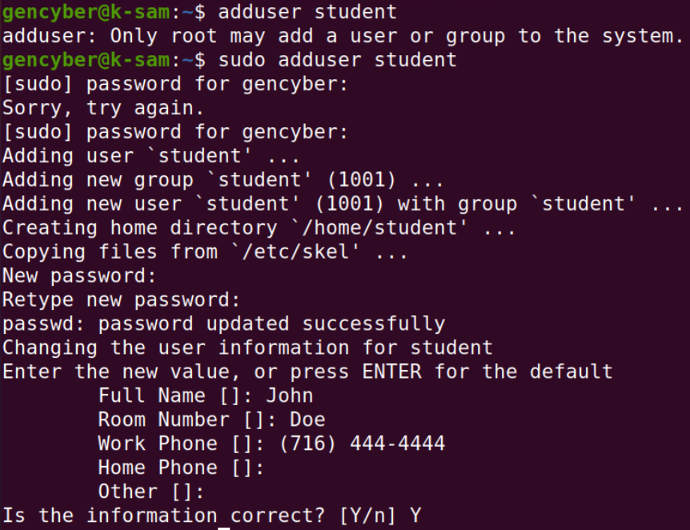
Create a User (Follow Along)
adduser student
sudo adduser student

Slide 33
Delete a User

Slide 34
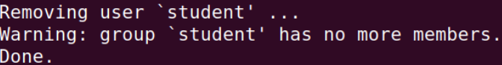
Delete a user (Follow Along)
sudo deluser student

Slide 35
Create and View Groups

Slide 36
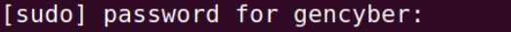
Create and View Groups (Follow Along)
sudo groupadd ub
cat /etc/group

Slide 37
Remove a Group

Slide 38
Remove a Group (Follow Along)
sudo groupdel ub

Slide 39
Adding a User to a Group

Slide 40
Adding a user to a group
usermod -a -G ub student

Slide 41
Steps (Try yourself)
sudo useradd student
sudo groupadd student
usermod -a -G ub student

Slide 42


Slide 43
More advanced commands
Vim
highly configurable text editor built to make creating and changing any kind of text very efficient
find
Allows the searching for specific files and file names.
List of 20 advanced commands
https://www.tecmint.com/20-advanced-commands-for-linux-experts/

Slide 44
SlidesCarnival icons are editable shapes.
This means that you can:
Resize them without losing quality.
Change fill color and opacity.
Isn’t that nice? :)

Slide 45
Diagrams and infographics

Slide 46
You can also use any emoji as an icon!
And of course it resizes without losing quality.
How? Follow Google instructions https://twitter.com/googledocs/status/730087240156643328
✋👆👉👍👤👦👧👨👩👪💃🏃💑❤😂😉😋😒😭👶😸🐟🍒🍔💣📌📖🔨🎃🎈🎨🏈🏰🌏🔌🔑 and many more...

Slide 47

Free templates for all your presentation needs
For PowerPoint and Google Slides
100% free for personal or commercial use
Ready to use, professional and customizable
Blow your audience away with attractive visuals

